Slide 1

US-China Cleantech Trade Friction
The Honorable Paula Stern
The Stern Group, Inc.
www.sterngroup.biz
March 2012

Slide 2
US-China Growing Trade Friction
Growing trade friction is the result of a maturing trade relationship
US policy drives in US-China trade relationship
  To increase Chinese investment in the US
  To crack down on China’s unfair trade practices
Notes:
Easy to see the US’s policies as hypocritical
However growing trade friction is the result of a growing trade relationship. Similar to the US relationship with Canada, our #1 trading partner.
IP protection is becoming more important for Chinese businesses as well
The Obama administration has filed 6 cases at the WTO since taking office, 5 of which have been against China. Averages about 2 per year (citation?)
Former President Bush’s administration averaged about 3 WTO cases a year between 2001 and 2009
China now adopts a more offensive stance against its major commercial partners. After 10 years of participation in the WTO and a first study phase during which Beijing has become familiar with the WTO dispute settlement mechanism as a third party in as many as 87 cases, China has appeared 23 times to the DSB as a defendant, and already eight times as a complainant.
http://www.thehindubusinessline.com/opinion/article2942935.ece
increasing government intervention leads to added friction
US government investigations of solar imports from China has led China to investigate US subsidies of its green energy industry and to bring cases against several US imports to China
http://www.natlawreview.com/article/sino-us-trade-increasing-government-intervention-leads-to-added-friction
In March 2012 Congress passed a bill that continues to allow the US to impose countervailing duties against NMEs like China and Vietnam, overturning a US court ruling from December 2011
Obama is set to sign the bill into law
China says that this ruling breaks both US and WTO law
http://www.reuters.com/article/2012/03/07/us-china-trade-idUSTRE8260N920120307
The new March 2012 rare earths case against China could also be a political move on President Obama’s part to respond to GOP criticism that he is soft on China
http://www.politico.com/news/stories/0312/73975.html

Slide 3
President Obama’s State of the Union 2012
Announced that the Department of Defense would make one of the largest commitments in history to renewable energy, focusing on the Department of the Navy
Announced the creation of a Trade Enforcement Unit to investigate “unfair trade practices in countries like China,” which was formally dubbed the Interagency Trade Enforcement Center (ITEC)
Notes:
Obama is essentially using the Navy as an answer to China’s command economy investments in renewable energy. Like the creation of NASA as an answer to Sputnik.
The Navy will purchase enough clean energy capacity to power a quarter of a million homes a year
The DOD is the single largest user of petroleum at about 330,000 barrels of oil a day. Within the DOD, the Navy is the second largest user at about 100,000 barrels a day.
Secretary of the Navy Ray Mabus created a “1 GW Task Force” to take on the project in late January
Navy’s 5 energy goals from 2009
Change the way the Navy and Marine Corps consider the lifetime energy cost of the system when awarding contracts during the acquisition process
By 2012 – create a "Green Strike Group" composed of nuclear vessels and ships powered by biofuels, deploy that fleet by 2016
The Secretaries of the Navy and Department of Agriculture signed a contract to purchase 450,000 gallons of advanced drop-in biofuel. The fuel will be used in a demonstration of the Green Strike Group this summer
By 2015 – reduce petroleum use in its 50,000 commercial vehicle fleet by 50% by phasing in hybrid fuel and electric vehicles
Produce at least half the shore-based energy requirements from renewable sources, such as solar, wind and ocean generated by the base
By 2020 – ensure at least 40% of the Navy's total energy consumption comes from alternative sources.
http://www.navy.mil/search/display.asp?story_id=49044
http://www.navy.mil/search/display.asp?story_id=64995
(related but not part of the SOTU)
U.S. Army Engineering and Support Center has issued a draft Request for Proposal (RFP) to purchase renewable power from renewable and alternative energy assets constructed and operated on or near military installations
This is part of the Department of Defense’s Congressional mandate to produce or procure at least 25% of its energy (both thermal and electric) from renewable resources by 2025
Army intends to enter into up to $7 billion in contracts through power purchase agreements (PPAs), as well as other available contracting authorities over the next 10 years
http://www.lexology.com/library/detail.aspx?g=df074182-06ce-478b-8892-e2f314d777e6&utm_source=Lexology+Daily+Newsfeed&utm_medium=HTML+email+-+Body+-+Federal+section&utm_campaign=Lexology+subscriber+daily+feed&utm_content=Lexology+Daily+Newsfeed+2012-03-13&utm_term=
“Interagency Trade Enforcement Center” (ITEC)
President Obama seeks $26 million and 50-60 people for the new agency
Will be supported by the Departments of Agriculture, Homeland Security, Justice, State, the Treasury, and the Intelligence Community
The USTR Ron Kirk will appoint the Director
The Secretary of Commerce John Bryson will appoint the Deputy Director
Was officially created when Obama signed an executive order on February 28, 2012
Leadership and core staff will be established by June (“within 90 days’)
http://www.washingtonpost.com/business/obama-budget-seeks-to-boost-trade-enforcement-ratchet-pressure-on-china/2012/02/11/gIQAADvg6Q_story.html
http://www.worldbulletin.net/?aType=haber&ArticleID=86465
http://www.firstpost.com/world/obama-eyeing-china-creates-trade-enforcement-unit-228744.html

Slide 4
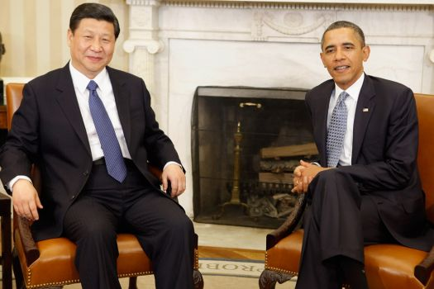
Vice President Xi Jinping’s US Tour
Notes:
Biden’s Remarks
"We're not always going to see eye to eye, but we have very important economic and political concerns that warrant we work together."
“As Americans, we welcome competition. But cooperation, as you and I have spoken about, can only be mutually beneficial if the game is fair.”
Included statements against China’s currency manipulation and demands of technology for doing business in China
Strong remarks possibly because it’s an election year
Desires that “the rules of the game are understood, agreed upon and followed.”
Obama’s remarks more diplomatic
Wants to make sure “everybody is working by the same rules of the road when it comes to the world economic system.”
“With expanding power and prosperity also comes increased responsibility,” Obama said, citing need for a “balanced trade flow” and “recognizing the aspirations and rights of all people.”
Xi’s remarks were firm
Demands for “mutual respect” and wants to “deepen mutual understanding”
Urges against US protectionism
Addressing US economic concerns: “The Chinese side has taken steps to address them and will continue to do so. We hope the U.S. side will take steps to address Chinese concerns.” Including lifting restrictions on high-tech exports to China.
Day after Biden’s toast, Xi stressed “core interests” in reference to territorial sovereignty and the issues of Taiwan and Tibet
http://www.nytimes.com/2012/02/15/world/asia/us-seeks-to-size-up-chinas-heir-apparent-during-visit.html
http://www.businessweek.com/news/2012-02-16/obama-tells-xi-china-s-rise-comes-with-duty-on-trade-rights.html
http://www.nytimes.com/2012/02/16/world/asia/vice-president-xi-jinping-of-china-urges-united-states-to-respect-core-interests.html?ref=world

Slide 5
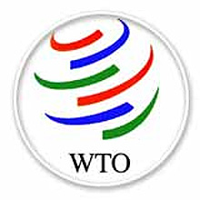
World Trade Organization
The World Trade Organization (WTO) sets trade rules and regulations for members based on principles that a nation shall treat the goods of all nations on a non-discriminatory basis
Both China and U.S. are members
Notes:
The trading system should be non-discriminatory.
The WTO puts forth two major policies relating to this:
MFN (Most Favored Nation)
All member countries must treat all trading partners equally.
National Treatment
Each member country must treat domestic and foreign products and services equally.
Does not allow member countries to give preferential treatment to its domestic products and services.
http://www.wto.org

Slide 6
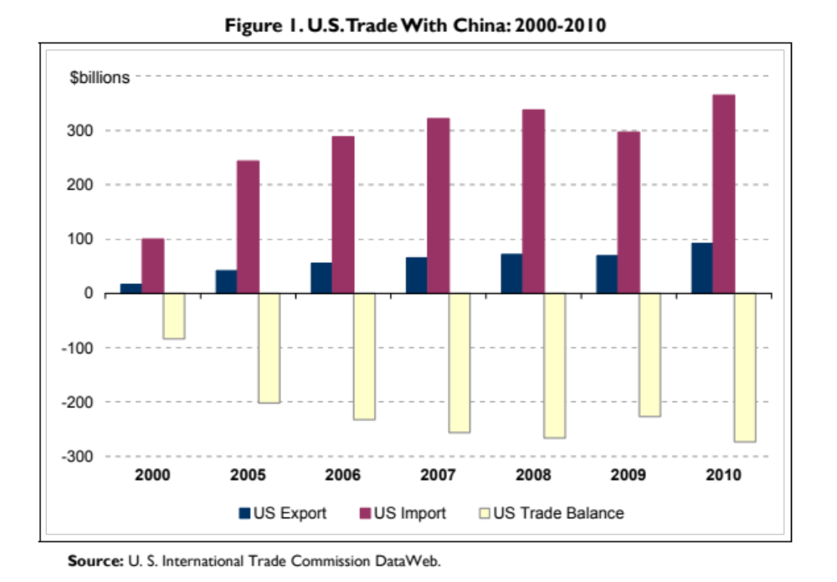
U.S. – China Trade
U.S. – China trade has risen from $2 billion in 1979 to $558 billion in 2011
China is U.S. second largest trading partner
U.S. – China trade deficit in 2011 was $295.5 billion
Notes:
China is US 3rd largest export market and its biggest source of imports.
Pending Cases
On September 15, 2010, the USTR’s office announced it was bringing a WTO case against China over its improper application of antidumping duties and countervailing duties on imports of grain oriented flat-rolled electrical steel from the United States. A panel was formed in May 2011, and a final report will be issued by May 2012. The panel ruled in favor of the United States, finding most of the challenged measures inconsistent with China’s WTO commitments. On July 20, 2012, China notified the WTO of its decision to appeal the panel’s ruling.
On September 15, 2010, the USTR’s office announced it was bringing a WTO case against China over its discrimination against U.S. suppliers of electronic payment services. A panel was formed in March 2011, and a final report will be issued by May 2012. On August 31, the WTO ruled that China did not obstruct foreign suppliers from entering the market.
On September 20, 2011, the US brought a case to the WTO against China over its AD/CVD on broiler products from the US. A panel was established on January 20, 2012, and the Director-General composed the panel on May 24, 2012. On November 23, 2012, the Chairman of the panel notified the DSB that the panel would be unable to issue its report within six months. After consulting with the interested parties, the panel projects that its final decision will be reached in June of 2013. http://www.wto.org/english/tratop_e/dispu_e/cases_e/ds427_e.htm
On March 13, 2012, the US, along with the EU, Japan, and Canada, brought a request for consultations to the WTO concerning China’s restrictions on exports of rare earths plus another two minerals, tungsten and molybdenum. On July 23, 2012, the DSB established a single panel to examine the dispute. On September 12, 2012, the US, EU, and Japan requested that the Director-General compose the panel, and the panel was composed on September 24, 2012. http://www.wto.org/english/tratop_e/dispu_e/cases_e/ds431_e.htm
On September 17, 2012, the US filed a trade dispute against China over subsidies to auto and auto parts manufacture. Consultations on the issue normally begin within 30 days. On September 28, 2012, the EU requested to join the consultations on this issue, which was accepted by China. If no satisfactory result is reached, the US has the right to request that the WTO establish a dispute settlement panel to examine the matter. http://www.wto.org/english/tratop_e/dispu_e/cases_e/ds450_e.htm
Resolved Cases
On June 23, 2009, the US brought a case against China regarding rare earths (bauxite, coke, fluorspar, magnesium, manganese, silicon metal, silicon carbide, yellow phosphorus, and zinc). US stated these policies lower prices for Chinese corporations giving them a competitive advantage. In response, China said they restricted exports because of environmental concerns. In July 2011, a WTO panel issued a report, which ruled many of China’s export restraints on raw materials violated WTO rules. The panel did not agree China’s restriction on these materials was justified because the restrictions were not the same for domestic and foreign producers. Also, China was not able to show restriction of rare earths improved public health or protected the environment.
On December 22, 2010, the USTR’s decided to bring a WTO case against China over government subsidies to Chinese wind power equipment manufacturers. These government subsidies were only applicable to the wind power manufactures who used Chinese made parts in their windmills. The subsidies did not apply to Chinese firms using foreign part in production, hence violating the WTO National Treatment agreement. On June 7, 2011, the USTR’s office announced China had agreed to end these subsidies due to investigatory actions taken by the USTR.
Really good information on US – China trade if you need to be refreshed
http://www.fas.org/sgp/crs/row/RL33536.pdf
All case information from the WTO website, in the section that contains trade dispute information.

Slide 7
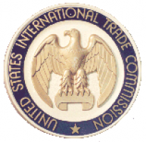
U.S. Trade Laws
Are designed to comply with WTO rules and principles
Permit U.S. interested parties to file suits against violations
Possible Actions:
  Galvanizing negotiations by threatening retaliation
  Imposing countervailing duties against unfair subsidies
  Imposing dumping duties against unfair pricing practices
  Countervailing and dumping actions can be taken simultaneously
  Imposing safeguards against “non - market economy” imports in the form of duties and/or quotas
Notes:
In the case of a potential WTO agreement violation – companies can petition the U.S. government to protect domestic industries in international competition
Galvanizing Negotiations by Threatening Retaliation:
Nobody wins when one country starts a trade war.
Countervailing Duties Against Subsidies
What are subsidies?
A form of financial assistance given to a business or economic sector.
Subsidies include: import restrictions, export subsidies, procurement subsidies, consumption subsidies, essentially any help particularly the government gives to a certain industry or sector.
The WTO Agreement
Allows governments to take action against subsidies if material injury is shown to the competing domestic industry.
Prohibited subsidies:
Specific subsidies, which is a subsidy only available to an enterprise, industry, group of enterprises, or group of industries in the country.
Subsidies that require recipients to meet certain export targets
Force companies to use domestic goods instead of imported goods to receive subsidy.
These subsidies are prohibited because they are specifically designed to distort international trade, therefore, likely to hurt other countries’ trade.
They can be challenged in the WTO dispute settlement procedure, but the subsidies must be shown to cause injury in the plaintiff’s market.
Possible causes of injury includes:
Injury to a domestic industry in the importing country.
Injury to rival exporters from another country when the two compete in a third market.
Injury to exporters trying to compete in the subsidizing country’s domestic market.
Regulates the actions countries can take to counter the effects of subsidies.
A country can launch its own investigation and ultimately impose a countervailing duty on subsidized imports hurting domestic producers.
Or, a country can use the WTO’s dispute settlement procedure to seek the withdrawal of the subsidy or the removal of its adverse effects.
If the Dispute Settlement Body rules that a subsidy does have an adverse effect on domestic producers, the subsidy must be withdrawn or its adverse effect must be removed. If not withdrawn, the plaintiff can impose countervailing duties to protect its industries or the subsidized exporter can agree to raise its export prices instead of a countervailing duty being imposed.
Countervailing duties can only be imposed after the plaintiff country has conducted a detailed investigation.
There are detailed rules for deciding whether a product is being subsidized (not always an easy calculation).
Specific criteria for determining whether subsidized products cause injury to a domestic industry.
Procedures for initiating and conducting investigations.
Rules on the implementation and duration (typically five years) of countervailing measures
Note: Subsidies play an important role in developing countries and in the transformation of centrally-planned economies to market economies. Least-developed countries and developing countries with less than $1,000 per capita GNP are exempted in the WTO agreement from disciplines on prohibited export subsidies.
http://www.wto.org/english/thewto_e/whatis_e/tif_e/agrm8_e.htm#subsidies
3. Anti-Dumping Duties Against Unfair Pricing
What is dumping?
Dumping is when a producer sells a product below the cost of production.
Or, sells a product abroad below the cost for their domestic market.
WTO Agreement
Permits governments to take action against dumping when there is material injury to the competing domestic industry.
Retaliation for dumping usually is in the form of an anti-dumping tariff, which is a tariff on the dumped product from that particular country.
The anti-dumping duty is imposed in order to return the dumped product to market value.
The WTO only allows three ways to determine where or not a product is being dumped.
Price in the exporter’s domestic market.
Price charged by an exporter in another country.
Sum total of the exporter’s production costs – price minus expenses
Just because a product is being dumped does not mean an anti-dumping duty can be imposed. Dumping must also be injuring the competing industry in the importing country.
Countries can take their cases to the WTO and the WTO will follow the same procedure taken against subsidies.
Determine whether dumping is occurring.
If there is dumping, an anti-dumping duty is permitted to be imposed or the dumping country can choose to put a tariff on the exported good to return the good’s price to normal value
Safeguards
What are safeguards?
A measure that is used to protect a home industry from sudden import increases from international competition.
Under WTO agreement
An import “surge” justifying safeguard action can be a real increase in imports (an absolute increase); or it can be an increase in the imports’ share of a shrinking market, even if the import quantity has not increased (relative increase).
A member may restrict imports of a product temporarily (take “safeguard” actions) if its domestic industry is injured or threatened with injury caused by a surge in imports.
The WTO agreement sets criteria for assessing whether “serious injury” is being caused or threatened, and the factors which must be considered in determining the impact of imports on the domestic industry
Also, a safeguard measure should be applied only to the extent necessary to prevent or remedy serious injury and to help the industry concerned to adjust.
When quantitative restrictions (quotas) are imposed, they normally should not reduce the quantities of imports below the annual average for the last three representative years for which statistics are available, unless clear justification is given that a different level is necessary to prevent or remedy serious injury.
A safeguard measure cannot last more than four years, although this can be extended up to eight years, subject to a determination by competent national authorities that the measure is needed and that there is evidence the industry is adjusting.
When a country restricts imports in order to safeguard its domestic producers, in principle it must give something in return.
The agreement says the exporting country (or exporting countries) can seek compensation through consultations.
If no agreement is reached the exporting country can retaliate by taking equivalent action.
The WTO’s Safeguards Committee oversees the operation of the agreement and is responsible for the surveillance of members’ commitments. Governments have to report each phase of a safeguard investigation and related decision-making, and the committee reviews these reports.
Special safeguards against non market economy imports
Countervailing and dumping actions simultaneously:
Since 2007, 2 dozen cases against China that have both countervailing and dumping relief
There have been controversies when using both remedies
US court dealt with off-road tires
3 part decision
Threw into question how useful it would be to bring both cases at once
Federal circuit is holding a trial for this case on October 6, 2011
3rd Country Subsidy or Dumping:
Show there is seriously prejudice on a 3rd market, then a case can be brought through a 3rd country
There has never been a 3rd country CVD case

Slide 8
Section 301 of the Trade Act of 1974
Administered by USTR
United Steelworkers Union (USWU) filed a petition under Section 301 of U.S. trade law to WTO – 9/9/2010
The petition covered five broad areas of WTO violations by China in the green technology sector
One claim in the 301 petition focused on the Chinese subsidized wind-power firms using domestic parts instead of imports
Under pressure, China agreed to remove the requirement forcing Chinese domestic wind-power manufacturer to use Chinese goods in production in order to receive government subsidies
Notes:
Petition areas
1. Restrictions of Access to Critical Materials
2. Prohibited Subsidies Contingent on Export Performance or Domestic Content
3. Discrimination Against Imported Goods and Foreign Firms
4. Technology Transfer Requirements for Foreign Investors
5. Trade-Distorting Domestic Subsidies
http://www.bbc.co.uk/news/business-13692255
http://assets.usw.org/releases/misc/section-301.pdf
China’s Special Fund for Wind Power Manufacturing illegally required aid recipients to use Chinese-made parts, the U.S. said in a case filed in December at the WTO after getting a complaint from the United Steelworkers union. Individual grants were for as much as $22.5 million.
“Subsidies requiring the use of local content are particularly harmful and are expressly prohibited under WTO rules,” U.S. Trade Representative Ron Kirk said in a statement. “We challenged these subsidies so that American manufacturers can produce wind turbine components here in the United States and sell them in China.”
http://www.businessweek.com/news/2011-06-07/china-to-drop-wind-power-subsidies-after-wto-case-u-s-says.html
http://www.metalbulletin.com/Article/2664620/AMM-USW-files-Section-301-trade-petition-against-China.html
http://www.ustr.gov/about-us/press-office/press-releases/2011/june/china-ends-wind-power-equipment-subsidies-challenged
United Steelworkers Union still trying to get the government to act on technology transfer requirements
http://justbrakes.co/reviews/2012/02/09/china-puts-us-auto-industry-at-risk-steel-and-auto-unions-tell-uncle-sam-to/

Slide 9
Section 421 of the Trade Act of 1974
ITC actions in response to dealing with non-market economy import surges
In 2009, several organizations together with the ITC filed a petition requesting an investigation of a surge in light truck tires imported from China under Section 421 of the Trade Act of 1974
Obama raised the 4% tariff on tire imports from China to 35%
China objected to tariff increase at WTO
In 2011 a WTO appellate body upheld President Obama's 2009 decision to impose emergency restrictions on imports of tires from China for three years
In 2013, Section 421 provisions against China will expire
Notes:
The petition addressed import surges from China, to examine whether Chinese passenger vehicle and light truck tires were causing market disruption to U.S. tire producers
35% in the first year of the safeguard, 30% in the second and 25% in the third.
Tires
Complaint by China over increase in US tire import tariffs
China agreed as part of its entry in the WTO to allow countries to impose such "safeguard" restrictions through 2013 in response to a market-disrupting surge.
The USITC determined that there were market disruptions because of rapidly increasing imports from China, which caused material injury to US domestic producers.
The President imposed extra duties on Chinese tires for 3 years.
China believes that the higher tariffs are not allowed under the GATT, so they went to the WTO to dispute the tariff.
WTO ruled in US favor, agreeing there was a significant increase in Chinese tire imports and these were causing material injury to US producers allowing the US to impose extra duties.
Can use same complaint against Chinese solar producers to try to get tariffs to control exports of solar panels coming from China
Try to show material injury due to the rapid increase in imports of Chinese solar panels
Material injury through Solyndra and Evergreen filing for bankruptcy and Solyndra cutting 1,100 jobs
Maybe can make the case to the USITC that temporary tariffs should be imposed on Chinese solar panels
http://www.reuters.com/article/2011/09/06/us-usa-china-trade-idUSTRE78573H20110906
http://international-trade-reports.blogspot.com/2011/07/chinese-tire-imports-section-421.html
http://www.ft.com/intl/cms/s/0/24bdb9f6-d8a8-11e0-9089-00144feabdc0.html#axzz1Y7lCZx3F

Slide 10
Major Subsidy Programs Around the World

Slide 11

Major Subsidy Programs EU
EU – Feed-in tariffs, investment subsidies, and tax incentives
Notes:
European Subsidies
The most important market for solar products mostly due to heavy subsidies.
However, extensive cuts of subsidies throughout Europe due to the economic slowdown.
This leads to more business for Chinese solar companies at the expense of European and American peers as customers seek lower cost products to protect profits
EU set a goal of reducing their 1990 carbon emissions level 20% by 2020
Debate over whether or not to increase the goal to 30%
Increasing the goal would reduce electricity costs for member states, but would require increased investments
http://ec.europa.eu/clima/policies/brief/eu/index_en.htm
http://ec.europa.eu/clima/news/articles/news_2012013002_en.htm
AD/CVD cases against China from the EU or EU Member States
25 July 2011, EU filed a case concerning China’s imposition of AD duties on x-ray security inspection equipment from the EU. A panel was established on January 20, 2012 and composed on March 12, 2012. The Chairman of the panel initially projected that a decision would be reached by December 2012, but due to unavoidable scheduling conflicts between two panelists, the decision has been delayed until January 2013. http://wto.org/english/tratop_e/dispu_e/cases_e/ds425_e.htm

Slide 12
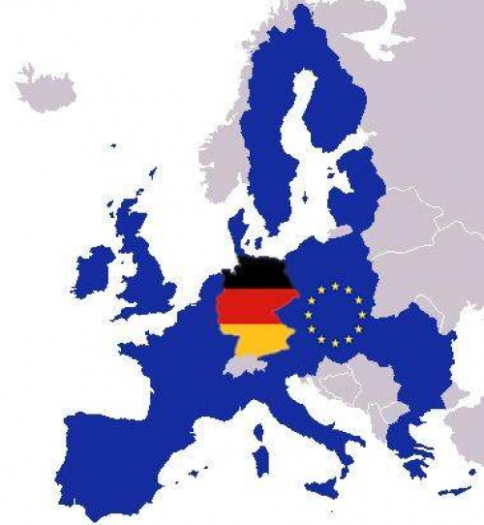
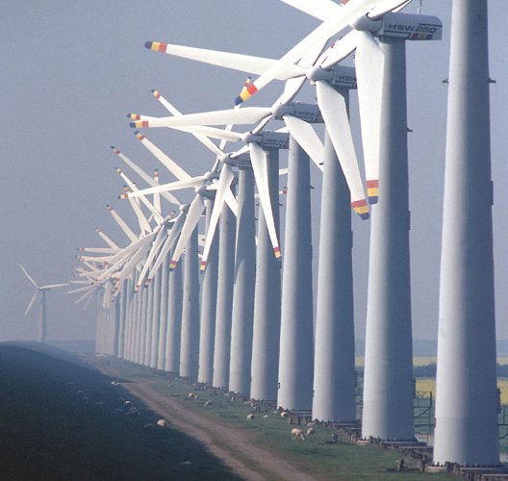
Germany
Notes:
History
energy crisis in 1970 s had a huge impact on renewable energy policy and in promoting environmental awareness
Led to government investment in renewable energy sources
Began with federal government R&D support for wind turbine development in 1974
A federal electricity feed law in 1991
Market incentive program in 1999
Renewable energy law in 2000. This is a fixed, regressive feed-in tariff for renewable sources
Current Policies Instruments
direct investment in R&D, direct subsidies, government-sponsored loans, tax allowances, subsidies for operational costs/feed-in tariffs
Today
Renewable energy sources account for 20% of Germany’s total electricity consumption in 2011 from only 6.4% in 2000 when they passed the renewable energy law
Overall, renewables accounted for 12% of Germany’s total energy consumption in 2011, including electricity, heat, and fuels
Added 7.5GW of new PV capacity in 2010, over 1/3 of the total 20.3 installed globally
http://www.germanenergyblog.de/?p=8311

Slide 13

Major Subsidy Programs U.S.
U.S. – tax incentives, subsidies, and grants
Notes:
In 2009, the US passed the America Relief and Reinvestment Act (ARRA), which encompasses a $787 stimulus package committing more than $70 billion to renewable energy
This fund will be fully spent by mid-2012.
Because of the economic slowdown and debt crisis, government tax credits, loan guarantees, and government research funding’s futures remain uncertain.
Also, US PTC (production tax credits) is mostly applicable to wind energy. The tax credits provide a 2.1 cent per kilowatt hour subsidy for the first 10 years of a renewable energy companies operation; expires in 2012
US ITC (Investment tax credits) is mostly applicable to solar energy. The tax credit provides up to 30% on all investments companies make into renewable energy expire in 2016.
In 2010, the US gave another $14.67 billion in subsidies and support to renewable energy industries
Biofuels received $6.64 billion
Wind received $4.98 billion
Solar and Biomass received $1.11 billion each
Hydropower received $216 million
Other received $614 million
A Federal tax credit for ethanol expired on December 31, 2011
Wasn’t really fought by ethanol producers because the market has changed and demand was less. Ethanol is 10% of the US’s gasoline supply.
http://www.nytimes.com/2012/01/02/business/energy-environment/after-three-decades-federal-tax-credit-for-ethanol-expires.html
In 2007, the US started a program ARPA-E (Advanced Research Projects Agency-Energy) to promote and fund research and development of advanced energy technologies.
This program is modeled after DARPA (which has been very successful in inventing technologies such as the Internet and Stealth technology).
It was created by the America COMPETES Act within the Department of Energy (DOE) in 2007.
Mission: To fund projects to decrease America’s dependence on foreign energy, reduce US energy related emissions, improve energy efficiency, and to ensure the US remains a technology and economic leader
ARPA is seeing some initial success with projects attracting $100 million in funding from the private sector in 2009-2010
Some of the projects ARPA is funding include: better batteries for transportation, more efficient energy grid storage, prevention of CO2 from coal plants entering into the atmosphere, use of microorganisms to create liquid fuels, and etc.

Slide 14
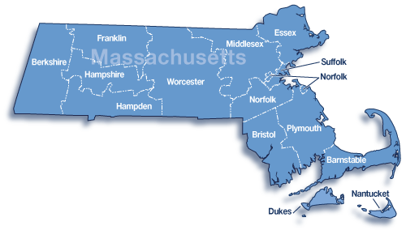
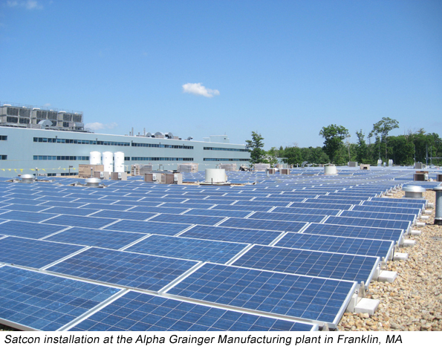
State Specific – Massachusetts
Notes:
Massachusetts has its own clean energy department: Massachusetts Department of Energy Resources.
Its mission is to ensure deployment of cost-effective energy efficiency, maximize development of clean energy resources, create and implement energy strategies to ensure reliable supplies and improve the cost of clean energy relative to fossil-fuel based generation, and to support Massachusetts’ clean energy companies and clean energy employment
To this end, Massachusetts offers state grants, low interest loans, property tax incentives, sales tax incentives, corporate Tax exemption/deductions, educational, technical, networking support, and personal tax credits
http://www.mass.gov/?pageID=eoeeamodulechunk&L=5&L0=Home&L1=Grants+%26+Technical+Assistance&L2=Guidance+%26+Technical+Assistance&L3=Agencies+and+Divisions&L4=Department+of+Energy+Resources+(DOER)&sid=Eoeea&b=terminalcontent&f=doer_pub_info_mission_statement&csid=Eoeea

Slide 15
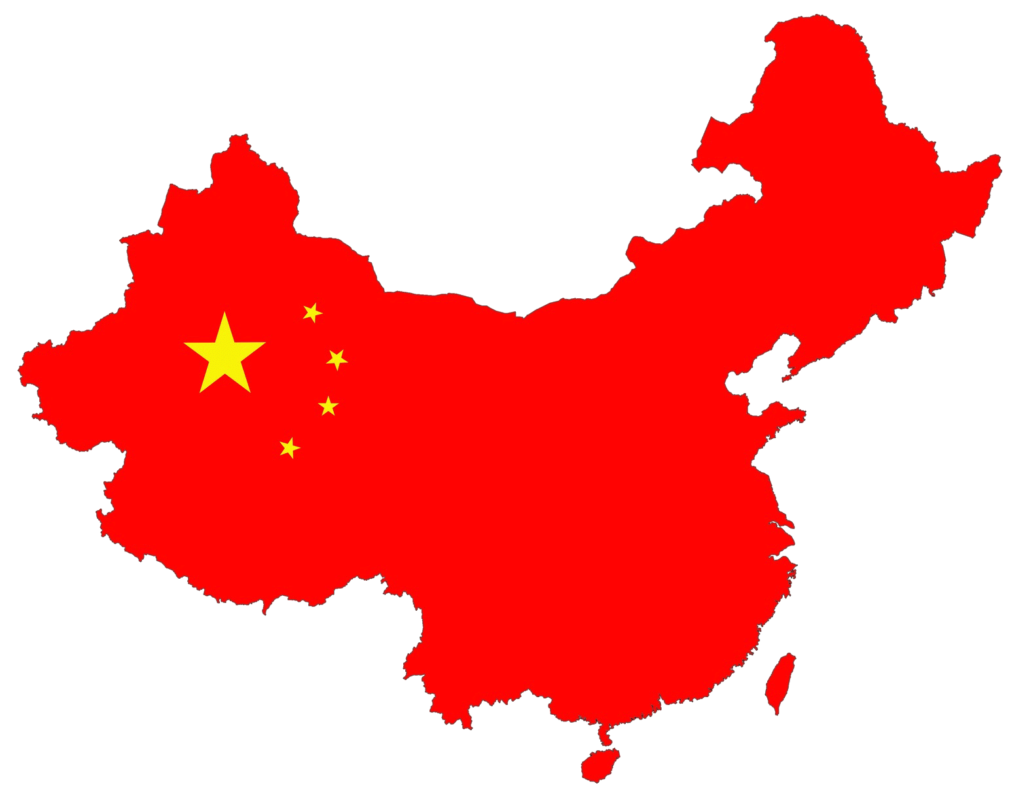
Major Subsidy Programs China
China – provides a wide range of subsidies, provision of land at no cost, R&D grants, factory construction incentives, advantageous financing, fixed feed-in tariffs, and local content requirements
Notes:
China
2010 is the first year developing states collectively received more financial new investment in renewable energy than developed states. Developing states receiving $72 billion while developed states received $70 billion, with China receiving just under $50 billion.
In the last 6 months the China Development Bank has lent $32 billion in low interest credit facilities to Chinese solar and wind companies
Although the local content requirement for wind turbines was taken to the WTO and China eventually yielded to pressure and removed its requirement, the requirement was in place for long enough to have a big effect on wind production and forced most multinational companies to move production to China. Now, because companies have moved their production to China, China does not need the local content requirement because most wind turbines are produced in China.

Slide 16
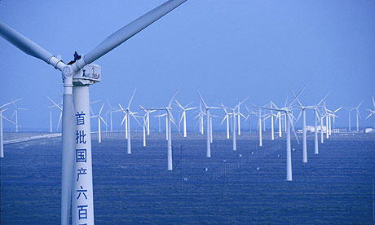
China
History
2005 – Renewable Energy Law
2010 – National Energy Commission (NEC) created
Currently the global leader in renewable energy
Chinese offshore wind farm completed in 2009
Notes:
History
1950s-1960s state allocated special funds to support hydropower
1970s subsidies offered to provide energy to rural areas
1980s because of reform and increased demand for electricity government expanded its subsidy, loan, and grant program to hydroelectricity.
1990s - altered their subsidy program into a tax reductions and exemptions program among other programs. Also, expanded the technologies that gained support from hydroelectric to include solar energy, wind power, biomass technologies, and other forms of renewable energy
http://www.nrel.gov/docs/fy04osti/36045.pdf
Current Policy Initiatives
China uses subsidies to promote growth in renewable energy and high technology, including wind and solar power and energy efficient cars.
In 2005, China passed its Renewable Energy Law committing China to developing its renewable energy resources.
In 2009, China spent roughly $35 billion to develop renewable energy compared to $19 billion in the US
Also in 2009, China launched its Global Sun program
This program offers government subsidies of up to 50% on solar investment
In 2010, China set up the NEC (National Energy Commission) with the responsibility of drafting the national energy development plan, coordinating national energy development and international cooperation, and review energy security.
Also in 2010, China provided $46.9 billion for clean energy commitments, the China Development Bank provided $35.3 billion in credit for 6 solar and wind energy equipment makers.
In 2011, China passed their 12th five year plan encouraging high speed rail, turning the coastal regions into high tech centers for R&D, and further construction of hydro electric power plants in the south of China.
This plan encompasses expanding their renewable energy power output by 235 gigawatts by 2015.
China is currently the global leader in renewable energy
In 2010, China made 39% of the wind turbines sold and 43% of the solar panels
In 2012, China invested $67.7 billion in total clean energy investment, up 20% from 2011 due to a surge in the solar sector
China also plans to join the International Renewable Energy Agency and is currently preparing its membership application
http://money.cnn.com/2010/09/21/news/international/china_renewables/index.htm
http://about.bnef.com/2013/01/14/new-investment-in-clean-energy-fell-11-in-2012-2/
http://www.thenational.ae/news/uae-news/environment/china-to-sign-up-for-green-energy-abu-dhabi-summit-hears

Slide 17
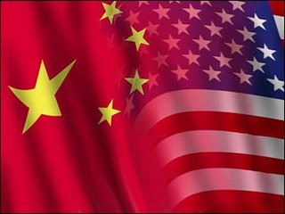
China’s “Potential” WTO violations triggering criticism and/or complaints
Subsidies & Dumping
Currency Manipulation
Export Controls
Technology Transfer requirements
Intellectual Property Rights violations

Slide 18
Wind Tower Trade Coalition
The Wind Tower Trade Coalition initiated a case in December 2011 at the International Trade Commission (ITC) and Department of Commerce (DOC) against wind tower dumping and countervailing duties from China and Vietnam
On February 10, 2012 the ITC issued a preliminary finding of a reasonable indication of material injury or threat to the US wind industry
Notes:
The case was sent to the Department of Commerce on February 21, 2012
Commerce decided in favor of American manufacturers and imposed duties of 13.7% to 26% on Chinese wind turbine imports
The CVD decision was originally due on March 23, 2012, but the deadline was extended
http://www.lexology.com/library/detail.aspx?g=d626c6bc-0ccd-4e72-b00c-10fa70fd28be&utm_source=lexology+daily+newsfeed&utm_medium=html+email+-+body+-+federal+section&utm_campaign=lexology+subscriber+daily+feed&utm_content=lexology+daily+newsfeed+2012-02-17&utm_term=
http://www.usitc.gov/trade_remedy/731_ad_701_cvd/investigations/2011/wind_towers/prelimphase.htm
http://ia.ita.doc.gov/frn/2012/1203frn/2012-5785.txt
http://www.google.com/url?sa=t&rct=j&q=&esrc=s&source=web&cd=5&ved=0CEEQFjAE&url=http%3A%2F%2Fia.ita.doc.gov%2Fdownload%2Ffactsheets%2Ffactsheet-prc-vietnam-uswt-adcvd-init-20120119.pdf&ei=txVNT_iSEYTi0QHS7829Ag&usg=AFQjCNHHJF93trEkhrRUFjTaecm0BJkr7Q

Slide 19
The Solar Panel Industry
Solyndra, Evergreen, SpectraWatt
US-China greentech trade friction:
Solyndra
  Filed for bankruptcy and laid off 1,100 workers
  Received $535 million in government loans as part of the 2009 stimulus
Evergreen
  Filed for bankruptcy and sold itself at auctions
  Received $58.6 million in grants, loans, land, and tax incentives in past years from Massachusetts
SpectraWatt
  Filed for bankruptcy
  Auctioned off assets, valued at $33.9 million
Notes:
Solyndra Reasons for Bankruptcy
Shut down in the face of competition from Chinese solar panel makers
Evergreen Reason for Bankruptcy
Increased competition from government-subsidized solar panel makers in China
Failure of US to adopt clean-energy policies
Because prices of US solar panels fell in 2010 and 2011, there is massive overcapacity in the industry at a time of lower subsidies (El Hillow said in court papers)
SpectraWatt Reason for Bankruptcy
Owes $38.7 million in debt
blames increasing competition from low-cost manufacturers in China and the falling prices of solar panels caused by an oversupply on the market
http://www.sustainablebusiness.com/index.cfm/go/news.display/id/22837
http://www.greentechmedia.com/articles/read/spectrawatt-sequel-after-collapsing-company-declares-bankruptcy/
http://ecotrope.opb.org/2011/09/wyden-how-to-stop-chinas-solar-power-takeover/

Slide 20
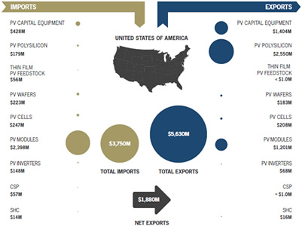
How to Define the Solar Industry According to http://www.seia.org/ - U.S. Net Exporter
Notes:
Defining the industry for purposes of petition for US import relief yields a different story
The U.S. is a significant net exporter of solar energy products with total net exports of $1.9 billion in 2010.
The United States is still dominant in the more complex—and more profitable—areas of making the wafers and silicon.
China has mostly cornered the market in the less-advanced sectors: making the cells and modules.
The U.S. has a trade deficit of $1.197 billion in PV Modules
2010 U.S. solar energy installations created a combined $6.0 billion in direct value, of which $4.4 billion (75%) accrued to the U.S

Slide 21
The Numbers: Looking at the Solar Industry
The four basic stages in solar module manufacturing are silicon purification, ingot and water manufacturing, cell production, and module assembly
The two stages China performs, cell production and module assembly, account for 60% of the cost of a module, but 18% of its profit
Notes:
Source: Council on Foreign Relations Michael Levi
Based on 2008 data from MINES Paristech’s research

Slide 22
SolarWorld Case
SolarWorld initiated a case in October 2011 against Chinese subsidies and dumping in the solar industry
The ITC issued a preliminary finding in December 2011 of a reasonable indication of material injury or threat from Chinese subsidies on cell and panel production
The Chinese exporters are defending themselves and retaliating by initiating an investigation into US dumping of polysilicon
Notes:
SolarWorld, a German company, can petition because it manufactures in the US.
US-based companies are multinationals producing in countries, in addition to China.
Possible follow up cases under 301 and 337 …
Legislative activity regarding treatment of currency manipulation as a subsidy.
On March 20, 2012, Commerce announced its affirmative preliminary decision on the CVD investigation and imposed tariffs on solar panel imports from China
The tariffs range from 2.9-4.73%, much lower than the predicted 20-30%
Changzhou Trina Solar Energy - 4.73%
Wuxi Suntech Power - 2.9%
All others - 3.59%
The tariffs may be applied retroactively, possibly going back to October 2011
http://www.nytimes.com/2012/03/21/business/energy-environment/us-to-place-tariffs-on-chinese-solar-panels.html?hp
http://www.renewableenergyworld.com/rea/news/article/2012/03/its-official-us-commerce-imposes-tariffs-on-chinese-solar-firms
Commerce will announce its preliminary decision on the AD investigation on May 17, 2012
Commerce will make its final decision on June 4, 2012
The ITC will make its final injury determination on July 19, 2012
The Chinese government has announced plans to squeeze out U.S. polysilicon manufacturers
http://www.huffingtonpost.com/leo-hindery-jr/china-solar-panels-_b_1323568.html?ref=technology&ir=Technology
http://theenergycollective.com/jimpierobon/76523/guest-opinion-solarworld-states-its-case-tariffs-chinese-solar-panel-imports-xi-ji
http://www.pv-magazine.com/news/details/beitrag/us-doc-forestalls-finding-in-solarworld-trade-petition-until-march-20_100005921/

Slide 23

Actions Against Subsidies Under WTO Rules
Impose US countervailing duties on imports benefitting from subsidies
  The subsidized imports must cause material injury or threat to domestic producers
Challenging subsidies in government-to-government action, through the WTO dispute settlement process in Geneva
Notes:
Ongoing Case in WTO:
The Japan-Canada dispute began on September 13, 2010, when Japan complained that the province of Ontario had established a feed-in tariff program, several aspects of which violated Canada’s commitments under the WTO’s Agreement on Subsidies and Countervailing Measures (SCM Agreement) and its Agreement on Trade-Related Investment Measures (TRIMS Agreement) (WTO, 2010).
A panel was composed on October 6, 2011. The panel majority dismissed Japan’s allegations on the grounds that Japan had failed to establish the existence of a subsidy and, therefore, that there was no basis to uphold Japan’s subsidization arguments.
http://www.wto.org/english/thewto_e/whatis_e/tif_e/agrm8_e.htm
http://www.wto.org/english/tratop_e/dispu_e/cases_e/ds412_e.htm
Similar Case:
A similar dispute between the US and China, over Chinese wind power subsidies that required domestic content (WTO, 2011), was announced as amicably settled in consultations. The terms of the agreement involve China’s termination of the program in question.
http://www.globalsubsidies.org/subsidy-watch/commentary/renewable-energy-subsidies-and-wto-wrong-law-and-wrong-venue
Government-to-Government Challenges of Subsidies
Rarely used, best example would be the case between US and EU concerning alleged subsidies to the production of large civil aircraft (LCA).
http://www.akingump.com/files/Publication/4f9cc541-a885-4762-bd0f-30c88365dfc5/Presentation/PublicationAttachment/0f334169-e46d-4f63-ac81-36a481f46b44/reprint_%20Janzen.pdf
http://www.ustr.gov/about-us/press-office/press-releases/2011/march/united-states-prevails-wto-dispute-over-large-civil

Slide 24
Other “Potential” WTO violations of China
Subsidies & Dumping
Currency Manipulation
Export Controls
Technology Transfer Requirements
Intellectual Property Rights Violations

Slide 25
WTO Rules Regarding Currency Manipulation
Currency manipulation creates a subsidy for exports and a tariff on imports
Arguably, this is a violation of Article XV (2 & 4) of the GATT agreement as well as Article IV, Section 1 of the IMF’s Articles of Agreement
Notes:
Legislative activity including that of Sen. Ron Wyden (D-Oregon) .
Calls for multilateral response. Former Deputy Trade Representative Ira Shapiro.
House Minority Whip Steny Hoyer (D-MD) told reporters on September 6, 2011 that House Democrats would push for a vote on a bill to direct the Commerce Department to investigate alleged Chinese "currency manipulation" as an actionable subsidy under U.S. trade law.
Senate passed a bill in October 2011 for the US to calculate currency undervaluation to determine if and to what extent imports are unfairly priced
http://democrats.waysandmeans.house.gov/media/pdf/111/2010Sep15_Shapiro_Testimony.pdf
http://af.reuters.com/article/energyOilNews/idAFN1E78716U20110908?pageNumber=1&virtualBrandChannel=0
http://www.reuters.com/article/2011/09/06/us-usa-china-trade-idUSTRE78573H20110906

Slide 26
Renminbi Manipulation
The Chinese currency (RMB) is undervalued by as much as 20% according to various estimates
The Economic Policy Institute estimates that 2.4 million American jobs have been lost or displaced since 2001 as a result of the trade deficit with China
To counteract the manipulation, U.S. Senator Sherrod Brown (D-OH) introduced the Currency Exchange Rate Oversight Reform Act of 2010, which was passed by Congress in October 2011
Notes:
http://thehill.com/blogs/congress-blog/economy-a-budget/119183-chinas-currency-manipulation-flipping-off-america-
http://brown.senate.gov/newsroom/press_releases/release/?id=8855c0da-f4f5-4776-a939-9b062be3c9c7
RMB expected to appreciate less than 5% in 2012, will still be undervalued
In 2004, the Yuan ended the year 8.28 to the dollar. In 2011, it ended the year 6.31 to the dollar, a 24-percent rise. In 2004, America’s trade deficit with China was $162 billion; in 2011, it was $295 billion. Those demanding a 30 percent appreciation got most of it—and the trade deficit mushroomed $133 billion
the trade deficit persists despite exchange rate moves
On March 14, 2012 Chinese Premier Wen Jiabao suggested that the appreciation of China’s currency was ending. He said that the Yuan was close to a level of equilibrium, though China would push for “a relatively big scale” of two-way fluctuation for the Yuan
http://online.wsj.com/article/SB10001424052702304450004577280331907336736.html?mod=googlenews_wsj
http://abcnews.go.com/Business/wireStory/wen-rise-chinas-yuan-15916050#.T2ERs8xrrqo
On April 16, 2012, People’s Bank of China widened the Yuan’s daily trading band from 0.5% to 1%, allowing for greater flexibility of the Yuan. This is the first widening since 2007. Both the Obama Administration and the IMF are pleased, calling this a significant step in the right direction.
http://www.globalresearch.ca/index.php?context=va&aid=30507
http://www.bloomberg.com/news/2012-04-19/yuan-band-may-challenge-companies-china-academic-says.html
http://www.ft.com/intl/cms/s/0/8d773dbc-1c2a-11e1-9631-00144feabdc0.html#axzz1ngceMqTg
http://www.economist.com/node/21532288
http://www.nytimes.com/2012/02/16/business/global/appreciation-in-chinas-currency-goes-largely-unnoted.html
http://blog.heritage.org/2012/02/13/some-truths-about-trade/

Slide 27
Other “Potential” WTO violations by China
Subsidies & Dumping
Currency Manipulation
Export Controls
Technology Transfer Requirements
Intellectual Property Rights Violations

Slide 28
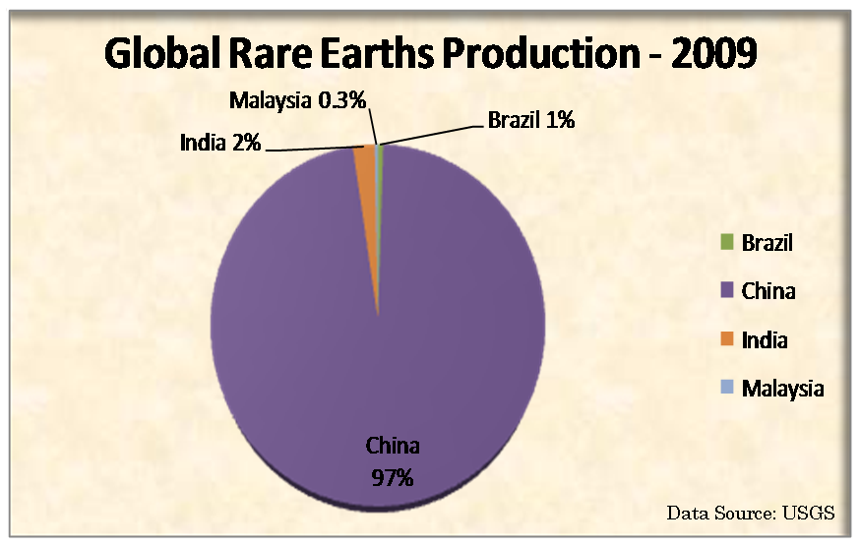
Export Controls: Raw Materials and Rare Earths
Rare Earth metals are crucial for the construction of green-tech innovations
China produces over 90% of Rare Earths
China applied a series of restraints to limit the exportation of rare earth’s and raw materials, including export duties and export quotas
  Both are direct violations of China’s WTO commitment and obligation
Notes:
While China produces over 90% of Rare Earths, they only possess about 50% of global reserves
The Chinese government has used quotas and high taxes on exports to prevent foreign companies from obtaining the precious minerals easily unless the companies moved their factories to China.
Prices have soared the last couple of years, and China is violating WTO rules according to some trade experts.
China said it largely shut down its rare earth industry for three months to address pollution problems.
By invoking environmental concerns, China attempted to circumvent international trade rules that prohibit export restrictions of vital materials.
Furthermore, China consolidated its industry to four state-owned companies which, even if the WTO orders China to dismantle its export tariffs and quotas, could enable China to retain tight control over exports and continue to put pressure on foreign companies to relocate to China.
http://www.extremetech.com/computing/122495-eu-japan-and-us-attack-chinese-rare-earth-monopoly
http://www.stewartlaw.com/stewartandstewart/Portals/1/Douments/GBD%20REE%20Paper%20Final.pdf
http://af.reuters.com/article/metalsNews/idAFL4E7K108X20110901
http://www.nytimes.com/2011/08/25/business/global/chasing-rare-earths-foreign-companies-expand-in-china.html?_r=1&pagewanted=1
http://www.bloomberg.com/news/2011-08-24/china-to-appeal-wto-raw-materials-finding-shen-says-correct-.html
http://www.stewartlaw.com/stewartandstewart/TradeFlows/tabid/127/language/en-US/Default.aspx?udt_583_param_detail=526
http://www.nytimes.com/2011/09/16/business/global/china-consolidates-control-of-rare-earth-industry.html?pagewanted=1

Slide 29
Export Controls: Raw Materials and Rare Earths
China agreed to remove export limitations to become a WTO member
After the EU, U.S., and Mexico brought raw materials cases to the WTO, a WTO panel, on July 5th 2011, published a report claiming China failed to uphold its WTO agreement
On January 12th 2012, the Appellate Body upheld the panel’s findings in part
On March 13, 2012, the US, EU and Japan requested consultations at the WTO concerning China’s export controls on rare earths.
Notes:
EU, Mexico, and US filed separate WTO cases regarding Chinese export restrictions on a broad range of raw materials that are needed in the production of steel, chemicals, and aluminum.
EU and Mexico won cases against China.
In January 2012 the WTO decided in favor of the US.
The panel found that China could not justify its policy on the grounds of protection of exhaustible resources for two reasons. First, because according to the panel this defense cannot be relied upon with respect to China's commitment to eliminate export duties, as set out in the Accession Protocol. Second, because the limitations in question did not lead to a reduction of extraction of minerals, but rather boosted domestic demand
The WTO findings did not apply to materials designated as Rare Earths
After China appealed the decision, the Appellate Body:
Upheld the panel recommendation for China’s export duties and quotas to follow its WTO obligations
Upheld the panel finding that there was no basis for China’s Accession Protocol – no reason not to uphold obligations to WTO
Upheld the panel finding that China’s export quota on refractory-grade bauxite was not temporarily applied
Reversed the panel finding that trade restriction must be aimed at ensuring the effectiveness of domestic restrictions
Declared moot and of no legal effect the panel’s rulings concerning claims related to export licensing requirements, minimum export price requirements, China's administration and allocation of export quotas, and fees and formalities in connection with exportation
http://www.wto.org/english/tratop_e/dispu_e/cases_e/ds394_e.htm
The March 2012 US/EU/Japan Rare Earths Case
Unless China unexpectedly gives in to the demands, the request for consultations will become a legal case in 60 days
Rare earths are important for the wind and solar power industries, as well as defense and electronics, and many foreign companies have moved their manufacturing sites to China in order to get around the export restrictions. This gives China an advantage in the production of electric vehicles, flat-screen televisions, smart phones and solar panels
The next step is for the US, EU and Japan to ask the WTO to establish a dispute-settlement panel to decide the case. Once appeals are lodged and heard, the process could take as long as two years to complete,
The dispute settlement panel for this case was composed on September 24, 2012.
http://www.nytimes.com/2012/03/13/business/global/trade-tensions-with-china-heating-up-again.html?_r=2&nl=todaysheadlines&emc=edit_th_20120313&pagewanted=all
http://etfdailynews.com/2012/02/29/chinas-domination-of-rare-earth-metals-puts-renewables-at-risk-fan-tan-kol-remx-chie-kol-gex-fxi/
http://www.reuters.com/article/2012/03/13/us-china-trade-eu-idUSBRE82C0JU20120313
http://www.joc.com/trade/us-takes-china-earth-metal-dispute-wto
http://www.internationallawoffice.com/newsletters/detail.aspx?g=9fd7c107-efd3-4db4-baf5-5db07c736636

Slide 30
Other “Potential” WTO violations of China
Subsidies & Dumping
Currency Manipulation
Export Controls
Technology Transfer Requirements
Intellectual Property Rights Violations

Slide 31

Volt Technology: General Motors
Notes:
Subsidies are allegedly available from the Chinese government for electric cars made by Chinese companies
The Volt does not qualify for these subsidies because it is not produced by a Chinese company
Chinese government reportedly refused to let the Volt qualify for subsidies unless GM transferred engineering secrets and coproduced the Volt with a Chinese firm
GM has reportedly moved all electrical vehicle (EV) developments to China.
The Chinese government is refusing to let the Volt qualify for subsidies totaling up to $19,300 a car unless G.M. agrees to transfer the engineering secrets for one of the Volt’s three main technologies to a joint venture in China with a Chinese automaker, G.M. officials said. Some international trade experts said China would risk violating World Trade Organization rules if it imposed that requirement.
According to the WTO Article 66.2 of the TRIPS (Trade-Related Aspects of Intellectual Property Rights) agreement, developed states are required to provide incentives for their companies to transfer technology to LDCs.
Article 7 of the WTO agreement states “that the protection and enforcement of intellectual property rights should contribute to the promotion of technological innovation and to the transfer and dissemination of technology.”
Although technological transfer is required under the WTO, the transfer has to abide by IPR.
Therefore, a firm in a developing state cannot steal a foreign firms technology and then use or sell it to other companies.
China is not a LDC it is an NIC (newly industrialized country), so technological transfer is optional and by China forcing technological transfer it is violating a number of other WTO agreements including National Treatment, GPA, and TRIMS.
Debbie Stabenow (Michigan Senator) is very outspoken about this because of the forced transfer of GM and Ford technological secrets to receive subsidies from the Chinese government for consumers to purchase their cars.
http://stabenow.senate.gov/?p=press_release&id=448
http://www.wto.org/english/tratop_e/trips_e/techtransfer_e.htm
http://www.nytimes.com/2011/09/06/business/global/gm-aims-the-volt-at-china-but-chinese-want-its-secrets.html
http://www.chinadialogue.net/article/show/single/en/4052-Cleantech-s-dirty-fight

Slide 32
Other “Potential” WTO violations of China
Subsidies & Dumping
Currency Manipulation
Export Controls
Technology Transfer Requirements
Intellectual Property Rights Violations

Slide 33
WTO Regulations for Intellectual Property Rights (IPR) Violations
Under WTO regulations, members must uphold IPR protection
If a member does not comply, then a case can be taken to the WTO
Section 337 is a US trade remedy designed particularly to address patent, copyright, or trademark violations.
  The bulk of Section 337 cases involve infringements of U.S. patents and trademarks
Notes:
IPR theft result in corporations not producing products in China for fears of having their technology stolen.
IPR concerns affect the products companies are willing to manufacture in China.
IPR concerns also affect R&D, sales, and product licensing.
Data Theft Case
In September 2011 the U.S. based American Superconductor accused its largest customer, the Chinese wind turbine maker Sinovel Wind Group Co. of Beijing , of stealing its intellectual property. American Superconductor has turned to authorities in Austria, China, and the United States as it presses criminal, civil, and commercial charges against Sinovel, which denies any wrongdoing.
AMSC has filed 3 cases in order to recover $1.2 billion for contracted shipments and damages
China courts dismissed the smallest of the 3 filed cases on February 3rd after Sinovel requested the case be taken to the Beijing Arbitration Committee. AMSC appealed the decision, but the Hainan Supreme Court upheld the lower courts decision in April 2012.
AMSC had its first court date with the Beijing Arbitration Commission on February 24, 2012.
http://www.ft.com/intl/cms/s/0/e5ba29a8-8246-11e1-9242-00144feab49a.html#axzz1rdxz45ug
http://www.boston.com/news/nation/articles/2011/09/19/us_china_ties_may_be_tested_as_american_superconductor_alleges_theft_of_wind_turbine_technology/?page=1
http://www.greentechmedia.com/articles/read/AMSC-Fights-For-Justice-in-China-Revives-Wind-Business/
http://phx.corporate-ir.net/phoenix.zhtml?c=86422&p=irol-newsArticle_Print&ID=1661245&highlight=
USTR_Special PDF found in “temporary map for Otto”
http://www.stewartlaw.com/stewartandstewart/PracticesServices/TradeRemediesPractice/Section337oftheTariffActof1930/tabid/76/language/en-US/Default.aspx

Slide 34
Challenges and Conclusions

Slide 35

Price
Price key to renewable energy policy implementation
Renewable energy competes with other energy sources that have been subsidized
Currently natural gas is the cheapest form of energy, but natural gas arguably is not as environmentally friendly
Onshore wind is currently the cheapest form of renewable energies
Solar energy is competitive with a 30% tax credit
Notes:
Solar energy tax credit is scheduled to remain through the end of 2016.
Solar energy prices are competitive with natural gas prices, but with a significantly lower environmental impact
http://www.greenbuildingadvisor.com/blogs/dept/energy-solutions/tax-credits-solar-energy-systems

Slide 36

Reducing the Risks of New Trade Conflicts
Negotiating new WTO rules
UN Framework Convention on Climate Change (UNFCCC) negotiation
Anti-dumping reform and tariff reduction at home
Collaboration
Notes:
New WTO rules
Potentially an agreement between WTO members on a new list of exempted subsidies linked to the development and diffusion of low-carbon energy sources.
Adoption of a new WTO agreement on trade in the Environmental Goods and Services Agreement (EGSA) could reduce the risk trade conflicts.
But, both of these are unlikely because the Doha Round negotiations are bogged down as governments struggle to resolve differences on politically charged issues such as agricultural market access.
To date, there is no WTO agreement on the scope of EGSA. WTO members unable to overcome an impasse on whether the scope of goods and services to be encompassed by EGSA should include biofuels.
Also, article 11 Technology Mechanism could serve as a platform for identifying types of cleantech funding that could be protected from WTO challenge.
as long as key WTO members see their economic competitiveness as inextricably linked to the success of their domestic cleantech companies, it seems unlikely countries will agree to give up the right to challenge subsidies in renewable energies.
UNFCCC
The UNFCCC process has serious limitations as a means of clarifying existing internationally agreed subsidies disciplines. Observers of the UNFCCC process have commented that climate change negotiators are looking to the separate realm of international trade negotiations to resolve such issues.
Anti-dumping Reform and Tariff Reduction at Home
Arguably, some of the most significant obstacles to US trade are at home
By liberalizing trade the US will increase competitiveness of its firms and decrease the number of lawsuits that can be brought through the WTO
Reforming/eliminating anti-dumping laws will make US companies more competitive because the majority of US companies use raw materials to produce more advanced products, thus decreasing the price of raw materials increases the profit of the resulting product.
Duty reduction on the products corporations use in their manufacturing process will also increase US competitiveness
http://online.wsj.com/article/SB10001424053111904716604576546910548548544.html?mod=ITP_opinion_0
http://www.akingump.com/files/Publication/4f9cc541-a885-4762-bd0f-30c88365dfc5/Presentation/PublicationAttachment/0f334169-e46d-4f63-ac81-36a481f46b44/reprint_%20Janzen.pdf

Slide 37
Current US-China Collaboration
Filling a Political Vacuum
Notes:
The National Council for Sustainable Development is working with the China Clean Development Mechanism Fund and China Central Television
American Council on Renewable Energy, US-China Program
US-China Energy Efficiency Forum
National Council for Sustainable Development
Is a national nonprofit
In April 2011, NSCD announced that they and CCT are producing a TV documentary series “Warm and Cold We Share Together…A Civilization Journey of Climate”
About global climate change, it’s history and changing impact on the environment and global populations
Working with CDM Fund in capacity building efforts under the China-U.S. Low Carbon Development Cooperation Program, CDM is also funding the documentary
The documentary will be released in November, showcased at a global climate event in South Africa by Hu Jintao
http://ncsdusa.org/press/press026.html
ACORE
Is a nonprofit
Mission of US-China Program (USCP) is to increase understanding and promote public and private relationships between the renewable energy markets both countries
Partner Organizations
Applied Materials, Du Pont, GCL-Poly Energy Holdings, Goldwind, Hudson Clean Energy, IMB, Orrick
Supporting Organizations
America and China International Foundation (ACIF), China Cleantech Focus, China Council for the Promotion of International Trade (CCPIT), China Greentech Initiative, China International Renewable Energy Conference and Exhibition (CREC | Solar), China New Energy Chamber of Commerce
http://acore.org/uschina/images/stories/documents/us-china%20program%20prospectus%202012.pdf
http://www.acore.org/uschina/index.php?option=com_content&view=article&id=48&Itemid=72
US-China Energy Efficiency Forum
1st was in May 2010 in China, 2nd was in May 2011 in Berkeley, CA
Part of the Energy Efficiency Action Plan created by Obama and Hu Jintao in 2009, to work together to improve the energy efficiency of buildings, industrial facilities, and consumer appliances, as part of the 10 Year Energy and Environmental Cooperation Framework
Haven’t seen a 3rd forum mentioned
http://www.2ndus-chinaeeforum.org/background.html
US-China Energy Efficiency Alliance
Is a nonprofit
Completely separate entity from the Forum
It’s a nonprofit that works with the National Resources Defense Council to fight global climate change by promoting energy efficiency in China
Comprised of experts on energy efficiency from both the US and China
Focuses mostly on creating regulations and initiatives within China
http://www.chinauseealliance.org/achievements.php
From Previous PowerPoint:
Collaboration
Joint efforts by Solar Energy Industries Association (SEIA) and U.S.-China Renewable Energy Forum and China’s Energy Rules and Association to determine what the role of government in renewable energy should be.
15 or so national trade associations
U.S.-China Clean Energy Research Center finances joint projects focusing on green building, clean coal, and next-generation vehicles.
Both countries are contributing equally to $150 million in financial support from public and private sources over five years
The last meeting I confirmed was on January 18, 2011 by CERC Steering Committee

Slide 38
Collaboration Recommendations
The International Centre for Trade and Sustainable Development and the Global Green Growth Institute are creating a Sustainable Energy Trade Agreement (SETA)
Multilateral approach: EU airline issue
Some argue to start with a small, US-China agreement on clean renewable energy
Notes:
International Centre for Trade and Sustainable Development (ICTSD) and the Global Green Growth Institute (GGGI)
Working together on a Sustainable Energy Trade Agreement Project (SETA)
“The SETA concept involves creating a sectoral free trade arrangement where sustainable energy products and services are traded among country participants without tariff and non-tariff barriers.”
Partly modeled on the Information Technology Agreement of 1996
The project started with a symposium in November 2011 in Washington.
2 more symposia will be held in 2012 at the ICTSD in Geneva and the GGGI in Seoul
http://www.gggi.org/research/gggi-research-initiative-sustainable-energy-trade-agreement-project
International Centre for Trade and Sustainable Development – Bridges China Dialogue (separate program)
Is a nonprofit NGO
Created in 2007
Mission is to improve “China’s globalization in a sustainable manner by engaging Chinese business leaders and policymakers in international multi-stakeholder conversations on governance, strategies, practices and global citizenship and establishing beneficial multilateral relations among China and other stakeholders throughout the world.”
The 4th annual dialogue was in September 2011, no future events have been mentioned
http://www.bridges-china.com/en/about%20us/Our%20story%20-%20about%20the%20ICTSD
CATO Institute
President Obama should designate China a market economy for the purposes of anti-dumping law
This has to be done by December 11, 2016 regardless
Chinese exporters would be subject legally to both the antidumping and countervailing duty laws, and they'd actually be happy enough about the change that the crucial bilateral relationship would get a much-needed boost.
http://www.cato.org/publications/free-trade-bulletin/trade-policy-priority-one-averting-uschina-trade-war?utm_source=Cato+Institute+Emails&utm_campaign=6d6a97aca4-Cato_Today&utm_medium=email&mc_cid=6d6a97aca4&mc_eid=ec9eb125aa
Multilateral approach
Both China and the US complain about the EU in the airlines issue
Best way to create an FTA is to start small, a US-China agreement on energy/environment, other countries will join in later, expand scope
Henry Kissinger
China’s new leadership-to-be will have always lived in a country at peace, they’ll need to deal with a changing society revolutionized by domestic and global economics, urbanization, and technology and communication
Trying to force a change in China’s institutions will likely backfire and isolate the liberals we intend to help
The situation should not be considered a zero-sum game, China’s rising power should not be seen as a strategic threat to the US
Both the US and China need to recognize that rhetoric feeds the other’s suspicions just as much as actual policy
The US needs military forces capable of speedy global action, but not bases surrounding China
US and China should use diplomacy to find areas of peaceful competition, Kissinger supports the concept of a Pacific Community
Failure to establish economic cooperation will harm other areas of potential cooperation
Both sides should accept the other’s activities as a normal part of international life, not as a burgeoning threat
http://www.foreignaffairs.com/articles/137245/henry-a-kissinger/the-future-of-us-chinese-relations?page=show

Slide 39
Chinese Investment in the US
In 2011 China invested approximately $5 billion in the US
The US currently receives only 2% of China’s outbound direct foreign investment
Waste-to-Energy technology is an unsubsidized form of renewable energy that has been left out of trade friction wars
Sierra Energy www.sierraenergycorp.com is a US company with effective waste-to-energy gasification technology
Notes:
Due to political controversy, many Chinese executives believe that the US does not welcome Chinese investment
In 2011, China invested about $5 billion in the US, around the same or possibly less than in 2010
In 2011, China invested more than $9 billion in Europe
http://finance.fortune.cnn.com/2012/02/23/chinese-investment-ireland/
US gets 2% of China’s outbound foreign direct investment (OFDI)
Many issues blocking Chinese OFDI in the US are internal to China
State-owned enterprises are internally focused, risk averse, and require government approval for overseas investments
Perceived (and sometimes real) political backlash
Regulatory resistance
Due to some failed attempts at investments Chinese executives believe the United States is unwelcoming of Chinese investment, even though the vast majority of Chinese investments in the United States have either been approved or have not required any approval
US would greatly benefit from more foreign direct investment (FDI)
FDI would expose companies of each country to the business cultures and habits of the others
Recommendations for US
Clarify and amplify that it is U.S. policy to attract Chinese investment
Bust myths and perceived biases
Quantify Committee on Foreign Investment in the US’s (CFIUS) reports on how transactions are improved
Remove impediments and irritants to FDI
Encourage private sector support for Chinese investments
Recommendations for China
Further open China to U.S. investment
Know the market
http://i.cfr.org/content/publications/attachments/Policy_Innovation_Memo13_Marchick.pdf
On April 26, 2012, Representative David Camp called on President Obama to create an investment treaty with China.
http://www.reuters.com/article/2012/04/26/usa-china-trade-idUSL2E8FQ3M220120426
Trade friction wars are due to subsidies on solar/wind/biomass/biofuel energies
Waste-to-energy hasn’t been subsidized, no friction
Due to lack of subsidies and friction, waste-to-energy is overlooked
The Chinese may want to encourage waste-to-energy
On April 10, 2012, China announced that it will pay developers of WTE plants 0.65 yuan (or 10 cents) per kilowatt-hour. Coal projects get 0.3 or 0.4 yuan. Wind projects get 0.61 yuan. Solar projects get at least 1 yuan.
Could be a similar situation to when IT blossomed in India because there were no protection policies
Waste-to-energy systems are predicted to treat at least 261 million tons of waste annually by 2022, with a total estimated output of 283 terawatt hours (TWh) of electricity and heat generation, up from 221 TWh in 2010
http://www.marketwatch.com/story/global-waste-to-energy-market-to-reach-292-billion-by-2022-forecasts-pike-research-2012-03-23
http://www.bloomberg.com/news/2012-04-10/china-sets-waste-to-power-price-double-that-of-coal-fired-plants.html

Slide 40
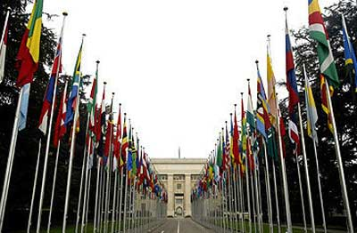
Divergent View in U.S. – Ambivalence
Who Could Bring the Case?
Private Companies
Multinational Corporations
Unions
US Executive Branch
US Congress
Hedge Funds
WTO Headquarters Geneva, Switzerland
Notes:
Private Companies
Private companies don’t want to risk retaliation from China
Multinational Corporation
Multinational corporations and trade associations in the clean energy business, as in many other industries have been wary of filing trade cases, fearing Chinese officials’ reputation for retaliation against joint ventures in their country and potentially denying market access to any company that takes sides against China
Unions
don’t have enough data to bring cases
Europeans
Europeans have seen massive price erosion in their solar panel market, but becayse of the debt crisis they are rethinking their policies and rethinking providing subsidies to greentech industries
US government
No administration wants to bring a case because if the administration brings one case all industries want the administration to bring cases to help them
ITIF: Enough is Enough: Confronting Chinese Mercantilism
Accused China of using currency manipulation, subsidies, tariffs, forced technology transfers, export restrictions, standard setting and other policies to gain an "absolute advantage" for its companies in a wide array of industries
“Companies are often reluctant to initiate complaints because they know that they will face retribution from the Chinese government. The US government should address this conundrum by making it national policy for USTR to bring cases whenever US interests are being hurt, even if US companies don’t want them to proceed.”
The US and free-trade allies need to “contain and roll back” Chinese mercantilism
Calls for blocs against China, a global free trade coalition with the EU, Canada, Australia, Japan and others to push back against China
Senator Ron Wyden
The US is “"losing the environmental goods economy to China”
“The (global trading) system breaks down when the world's participants fail to abide by its rules. That is especially true when the country that appears to be breaking the rules has the world's second largest economy.”
http://www.worldbulletin.net/?aType=haber&ArticleID=86465
Elected Officials
Most likely people to vote for a cause and bring cases
Senator Wyden
http://www.nytimes.com/2010/09/09/business/global/09trade.html
Hedge funds:
Don’t understand how to get greater value out of the assets they have bought
Underestimate China
Slow to bring cases
Don’t understand structure of ownership in industry

Slide 41

While Washington debates subsidies, climate change, and trade, other U.S. interests seek new commercial opportunities with China.
  One way for U.S. startups to benefit is to license or partner with Chinese firms
  “In manufacturing, China has made great progress, but for R&D and design, China is still very weak” – Zou Ji, China Country Director for the World Resources Institute
Notes:
Cleantech R&D spending in China has grown more than 20% annually over the past 10 years, compared to 5-6% growth rates in Europe, the U.S. and Japan.
America has advanced technology, while China has the capital and market that technology companies need. Cooperation is essential to innovation in this area.
“There is a rapidly emerging innovative ecosystem in China that could be the potential partners for overseas companies. You have a choice to either engage now and be aware of innovation and technology being developed in China, or be surprised later, when (Chinese) companies begin to compete globally” – Chris Hartshorn, vice president of research at Lux Research.
Source：Reuters -U.S. Cleantech Startups to Transform China 'Threat' Into Opportunity
http://www.reuters.com/article/2011/07/12/idUS211106702720110712
Source: CHINA: Clean technology -- a difficult balance between cooperation and competition
http://www.eenews.net/public/climatewire/2011/01/17/1

Slide 42
Thank You
Contact:
The Honorable Paula Stern, PhD
Chairwoman, The Stern Group
Work: 202.966.7894
Email: pstern@sterngroup.biz
www.sterngroup.biz

